Slide 1

What Do I as an IT Pro Need to Know About Containers and Kubernetes?
Vinicius Apolinario
Sr. Cloud Advocate
Microsoft
@vrapolinario

Slide 2

What is the problem we need to solve?

Slide 3
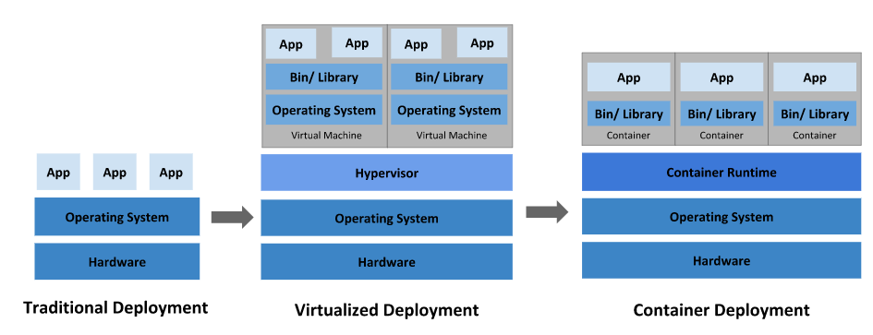
Traditional vs. Container

Slide 4


Slide 5

Container orchestration

Slide 6

Kubernetes
Pod/container placement/scheduling
Automated rollout/rollback
Storage orchestration
Load balance and Failover
Auto-scale
Self-healing pods
Horizontal scale
Extensible

Slide 7

How Kubernetes works (A user point of view)

Slide 8
sample-app.yaml
apiVersion: apps/v1
kind: Deployment
metadata:
name: sample-app
labels:
app: sample-app
spec:
replicas: 1
template:
metadata:
name: sample-app
labels:
app: sample-app
spec:
nodeSelector:
"kubernetes.io/os": windows
containers:
- name: sample-app
image: mcr.microsoft.com/windows/servercore/iis:windowsservercore-ltsc2022
resources:
limits:
cpu: 1
memory: 800M
requests:
cpu: .1
memory: 300M
ports:
- containerPort: 80
selector:
matchLabels:
app: sample-app
Deployment
Pod
Container

Slide 9
sample-app.yaml
apiVersion: apps/v1
kind: Deployment
metadata:
name: sample-app
labels:
app: sample-app
spec:
replicas: 2
template:
metadata:
name: sample-app
labels:
app: sample-app
spec:
nodeSelector:
"kubernetes.io/os": windows
containers:
- name: sample-app
image: mcr.microsoft.com/windows/servercore/iis:windowsservercore-ltsc2022
resources:
limits:
cpu: 1
memory: 800M
requests:
cpu: .1
memory: 300M
ports:
- containerPort: 80
selector:
matchLabels:
app: sample-app
Deployment
Pod
Container

Slide 10
Deployment
Pod
Pod
Container
Container

Slide 11
service.yaml
apiVersion: v1
kind: Service
metadata:
name: sample-app
spec:
type: LoadBalancer
ports:
- protocol: TCP
port: 80
selector:
app: sample-app
Deployment
Pod
Pod
Container
Container
Service

Slide 12
Sample-app
Deployment
Pod
Pod
Pod
Container
Container
Container
Service

Slide 13
Sample-app
Deployment
ConfigMap
DB connection
Other app config
Pod
Pod
Pod
Container
Container
Container
DB
Secret
Username
Password
Service

Slide 14
Namespace
Sample-app
Deployment
ConfigMap
DB connection
Other app config
Pod
Pod
Pod
Container
Container
Container
DB
Secret
Username
Password
Service

Slide 15
Kubernetes architecture (An admin point of view)

Slide 16
Internet
Kubernetes control
Worker node
kubelet
kube-proxy
Container runtime
Master node
Prod
Prod
API server
Pods
Pods
-controller-manager
-scheduler
Worker node
kubelet
kube-proxy
replication, namespace, serviceaccounts, etc.
etcd
Container runtime
Prod
Prod
Pods
Pods

Slide 17

Azure Kubernetes Service

Slide 18
Internet
Kubernetes control
Worker node
kubelet
kube-proxy
Container runtime
Prod
Prod
Pods
Pods
AKS managed
Worker node
kubelet
kube-proxy
Container runtime
Prod
Prod
Pods
Pods

Slide 19
Azure Kubernetes Service
Responsibilities | DIY with Kubernetes | Managed Kubernetes on Azure
Containerization
Application iteration, debugging
CI/CD
Cluster hosting
Cluster upgrade
Patching
Scaling
Monitoring and logging
Customer
Microsoft

Slide 20

Demo: Deploying an application in Kubernetes

Slide 21
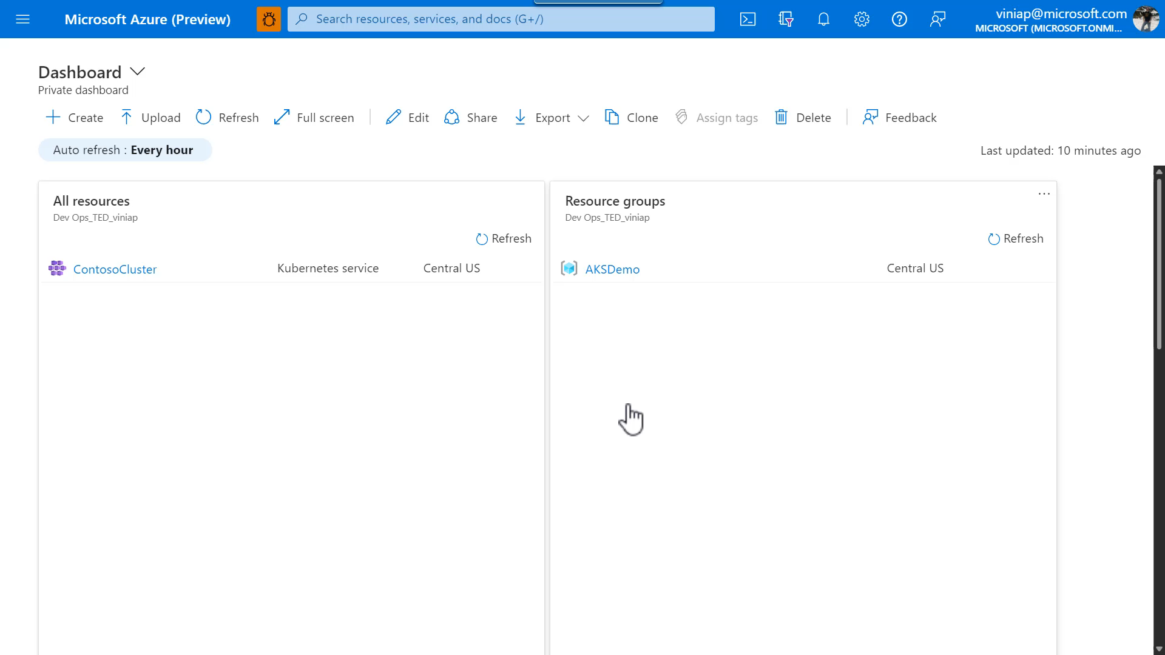

Slide 22

Kubernetes and DevOps

Slide 23






E2E experience
AKS production cluster
Web tier
Inner loop
Azure Container Registry
Source code control
Azure Monitor
Azure DevSpaces
AKS dev cluster
Test
Debug
Business tier
Auto-build
Azure Pipelines/ DevOps Project
Helm chart
Database tier
CI/CD

Slide 24
GitOps Demo

Slide 25
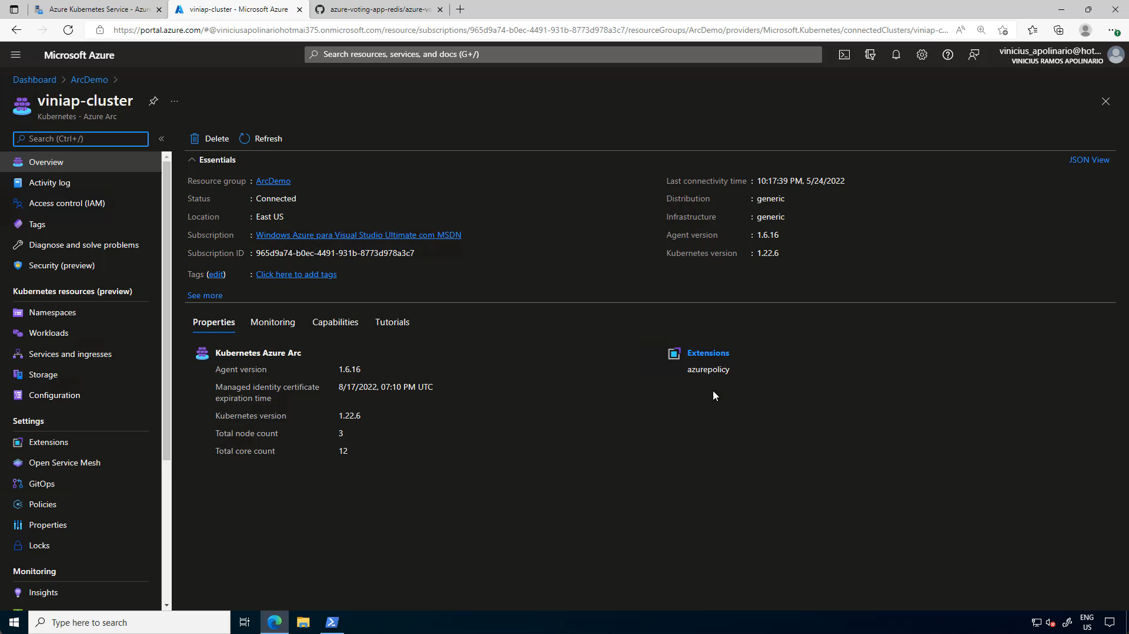

Slide 26

Real life scenario

Slide 27
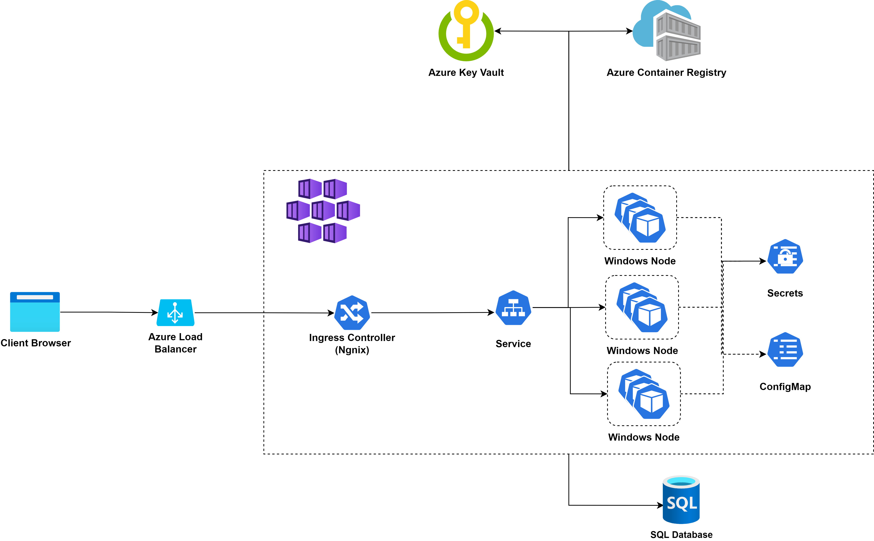

Slide 28

Demos: IT Ops best practices with Windows containers & AKS

Slide 29
Demo 01: SSL certificate management with containers and Kubernetes

Slide 30
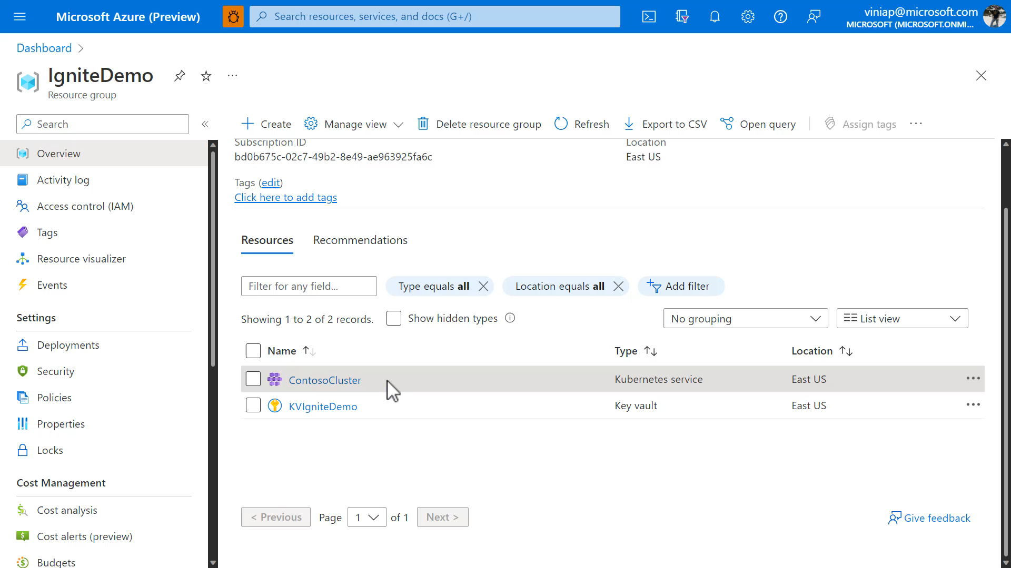

Slide 31
Demo 02: Removing hardcoded config from container images

Slide 32
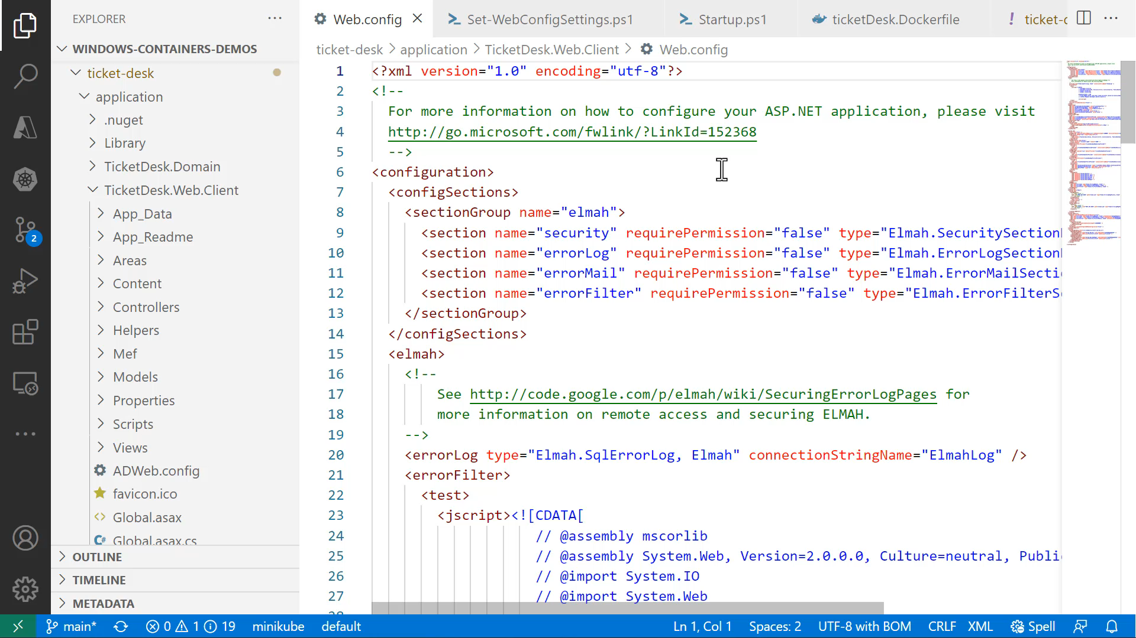

Slide 33
Demo 03: Automatic node scale out

Slide 34
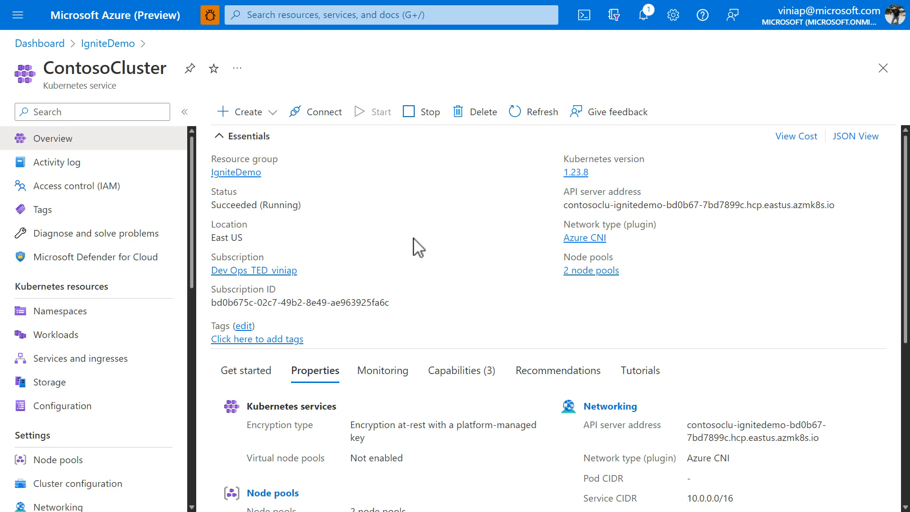

Slide 35
Demo 04: Seamless node OS upgrade

Slide 36
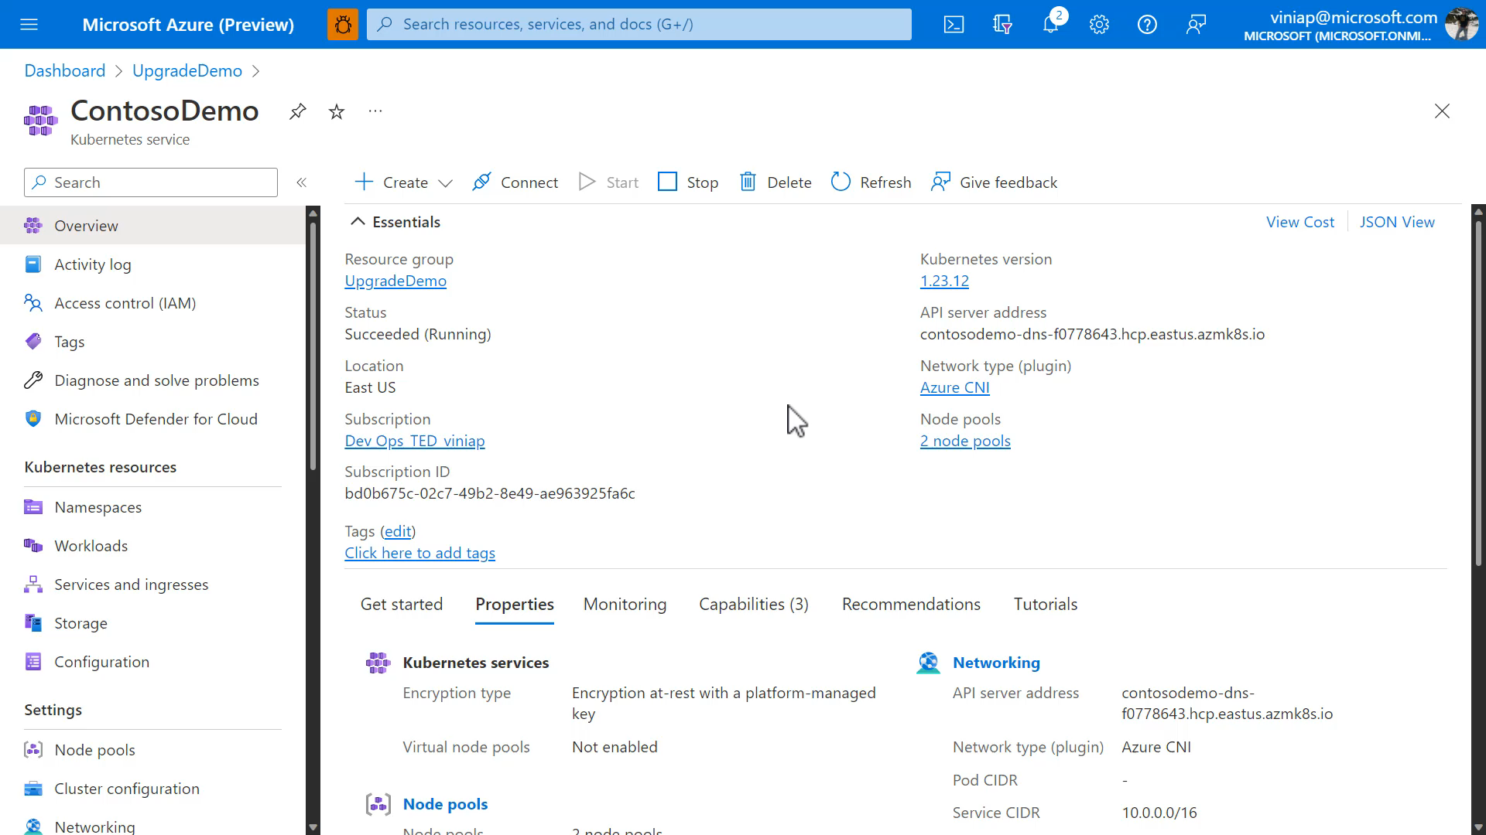

Slide 37
Demo 05: Remote IIS management (via MMC)

Slide 38
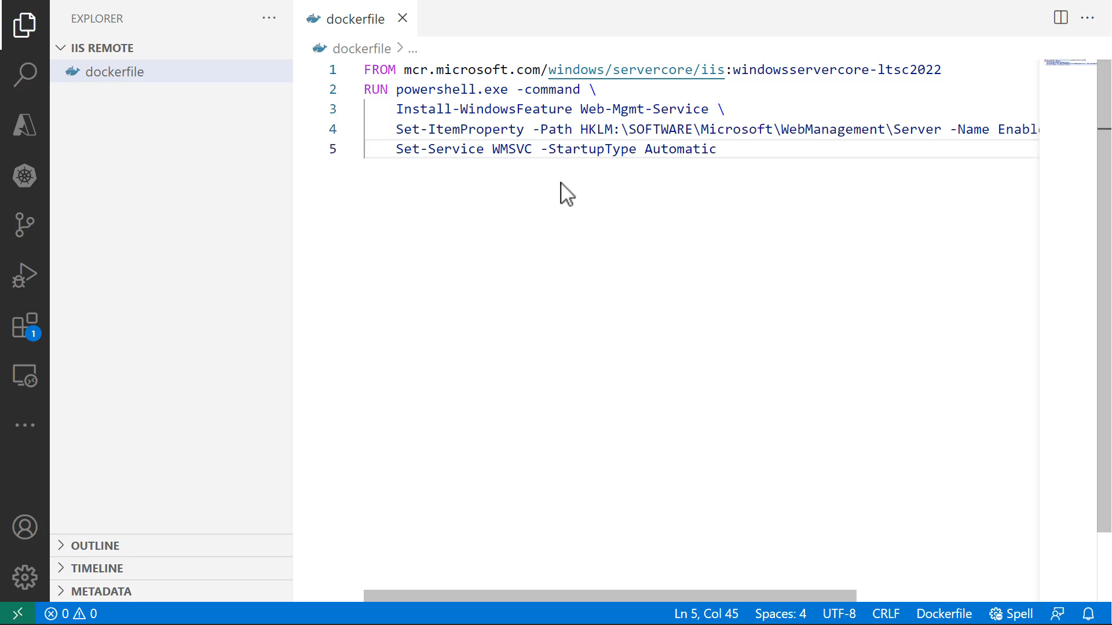

Slide 39

Conclusion

Slide 40
Resources
aka.ms/containers
Learn more about Windows containers
aka.ms/k8sLearning What is Kubernetes
aka.ms/WinContainersPath
Learning Path: Deploy, manage, and monitor Windows containers on Azure Kubernetes Service

Slide 41

Thank you!
Vinicius Apolinario
Sr. Cloud Advocate
Microsoft
@vrapolinario
Session Survey

